Slide 1
Joint Training for Pivot-based Neural Machine Translation
Yong Cheng, Qian Yang, Yang Liu, Maosong Sun, Wei Xu
2017 /8/23
Notes:
Good afternoon, everyone. My name is Yong Cheng, I am very glad to share my work with you. I am now working at Tencent AI lab. This work was done when I was a Phd student at Tsinghua University. The title of my paper is Joint training for pivot-based NMT.

Slide 2
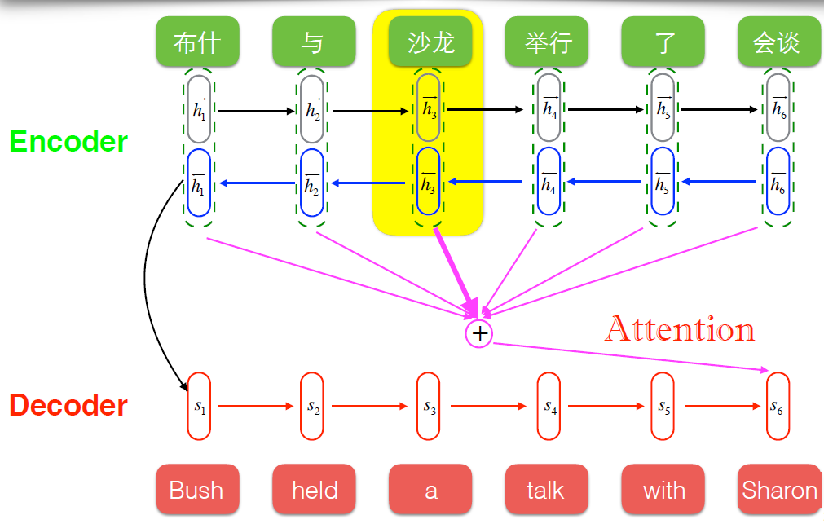
Neural Machine Translation
NMT: an end-to-end translation framework
Notes:
NMT is an end-to-end translation framework, which consists of an encoder and an decoder. The encoder encodes the source sentence to a fix-length real-value vector. Then the decoder is used to generate the target sequence. The attention mechanism plays a role to capture the relevant parts of source sentence to replenish the context information of the decoder. Thanks to the capability of learning representations from training data, NMT systems have achieved significant
improvements over conventional statistical machine translation (SMT) across a variety of language pairs.

Slide 3
Data Bottleneck in Neural Machine Translation
NN is a data-driven technique.
NMT heavily depends on the quantity of parallel corpora.
NMT suffers from the unavailability of large-scale parallel corpora for low-resource languages or domains.
Notes:
But as we know, neural network is a data-driven technique. Because nmt is completely based on NN, it also heavily depends on the quantity of parallel corpora. Unfortunately, large-scale parallel corpora are usually non-existent for most language pairs. Without sufficient training data, NMT tends to learn poor estimates on low-count events.

Slide 4
Pivot-based NMT
X
Y
MT system
Notes:
So we introduce pivot-based NMT to deal with this problem. We first show what is pivot-based NMT. Given a source language x and a target language y, the source-to-target NMT model can be trained on a source-target parallel corpora.

Slide 5
Pivot-based NMT
X
Y
MT system
No Parallel Corpora
Notes:
Unfortunately, parallel corpora are usually not readily
available for low-resource language pairs. So when we have no parallel corpora for x-to-y, how to build a fine MT translation system?

Slide 6
Pivot-based NMT
X
Y
MT system
No Parallel Corpora

Slide 7
Pivot-based NMT
X
Z
Y
MT 1
MT 2
$$P(z|x;θ_{x→z})$$
$$P(y|z;θ_{z→y})$$
Notes:
Fortunately, we can assume that there exists a third language called pivot language available. We will have source-to-pivot and pivot-to-target corpora. Generally, English can play this role as a Pivot language. So we can build two translation models, x-to-z and z-to-y translation model. And We can bridge x-to-y translation with z, English as the pivot language. The source-to-target model is decomposed into two sub-models or two sub-tasks. The pivot-based decoding approach will contain a two-stage translation strategies. Given a source-language sentence, the source-to-pivot NMT model First translates it to the pivot language sentence, from which the pivot-to-target NMT model generate a target-language sentence.

Slide 8
Error Propagation in Pivot-based NMT
X
Z
Y
MT 1
MT 2
Errors
$$P(z|x;θ_{x→z})$$
$$P(y|z;θ_{z→y})$$
Notes:
Although pivot-based approaches are widely used for addressing the data scarcity problem in machine translation, they suffer from cascaded translation errors:

Slide 9
Error Propagation in Pivot-based NMT
X
Z
Y
MT 1
MT 2
Errors
$$P(z|x;θ_{x→z})$$
$$P(y|z;θ_{z→y})$$
Problem: the errors made in the source-to-pivot translation will be propagated to the pivot-to-target translation.
Notes:
the mistakes made in the source-to-pivot translation will be propagated to the pivot-to-target translations. The error contained in the pivot-language translations directly affects the accuracy of the target language sentence.

Slide 10
Error Propagation in Pivot-based NMT
X
Z
Y
MT 1
MT 2
Errors
$$P(z|x;θ_{x→z})$$
$$P(y|z;θ_{z→y})$$
The discrepancy between source-pivot and pivot-target parallel corpora since they are usually loosely-related or even unrelated.
Source-to-pivot and pivot-to-target translation models are trained independently
Notes:
This can be partly attributed to the model discrepancy problem: the source-to-pivot and pivot-to-target
models are quite different in terms of vocabulary and parameter space because the source-pivot and pivot-target parallel
corpora are usually loosely-related or even unrelated. What is worse, the source-to-pivot model P(zjx; x!z) and the pivot-to-target model P(yjz; z!y) are trained on the
two parallel corpora independently, which further increases the discrepancy between two models

Slide 11
Joint Training for Pivot-based NMT
X
Z
Y
MT 1
MT 2
$$P(z|x;θ_{x→z})$$
$$P(y|z;θ_{z→y})$$
x-to-z likelihood
z-to-y likelihood
connection term
Notes:
To alleviate the model discrepancy problem, we propose an joint training approach for Pivot-based NMT. The objective contains three parts, x-to-z likelihood , y-to-z likelihood, and
Connection term. Which together aims to enable the two translation models to interact with each other during training. Among them, connection term plays a key role to associate the parameters of
The two translation models.

Slide 12
Challenges in the Connection Terms
The source-to-pivot and pivot-to-target models are distantly-related by definition.
NMT lacks linguistically interpretable language structures such as phrases in SMT to achieve a direct connection at the parameter level.
Notes:
It is difficult to connect the source-to-pivot and pivot-to-target models during training because the source-to-pivot and pivotto-target models are distantly-related by definition. More importantly, NMT lacks linguistically interpretable language structures such as phrases in SMT to achieve a direct connection
at the parameter level. In our work, we proposes three kinds of connection terms.

Slide 13
Connection Terms
Hard Sharing
Notes:
In the first connection term, because both the source-to-pivot and pivot-to-target models include the word embeddings of the pivot language as parameters. It is possible to connect these two models via pivot word embeddings. The first connection term is called hard sharing, which encourages the two models to generate the same pivot word embeddings. We guarantee the identical pivot word embeddings
between these two models through sharing the same word embeddings of the intersected pivot words.

Slide 14
Connection Terms
Hard Sharing
Soft Sharing
Notes:
As word embeddings seem hardly to be exactly identical
due to the divergence of natural languages, an alternative is
to soften the above hard matching constraint by penalizing the distance.

Slide 15
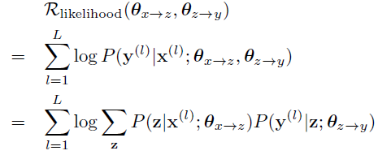
Connection Terms
Hard Sharing
Soft Sharing
Likelihood
Notes:
In the third connection term, assume we have a very small source-to-pivot corpora, and we think this phenomenon is not unusual. So we directly define the log-likelihood of the source-to-pivot parallel sentences as the combination score of two sub-models. In this formula, we can find the pivot language sentences as latent variables.

Slide 16
Experiments (Europaral)
Experimental Results on Spanish-French and German-French translation tasks with English as pivot languages.
Notes:
We evaluated our approaches on two translation tasks of two different corpora. The euraoparal is a relatively small corpus. This shows the comparison results between our joint training on three connection terms and independent training on the Europarl Corpus. For the source-to-target translation task, we present source-to-pivot, pivot-to-target and source-to-target translation results compared with independent training. In Spanish-to-French translation task, soft connection achieves significant improvements in Spanish-to-French and Spanish-to-English directions although hard connection still performs comparably with independent training. In contrast, we find that likelihood connection dramatically improves translation performance on both Spanish-to-French and German-to-French corpora. The significant improvements for source-to-pivot and pivot-to-target directions are also observed. This suggests that introducing source-to-target parallel corpus to associate these two translation models.

Slide 17
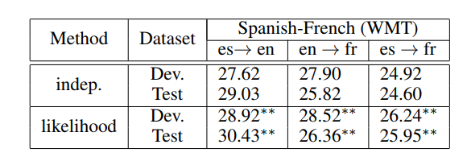
Experiments (WMT)
Experimental Results on Spanish-French translation tasks.
Notes:
Likelihood connection obtains the best performance in our
three proposed connection terms according to experiments
on the Europarl corpus. To further verify its effectiveness,
we evaluate all the methods on the WMT corpus, which is
much larger than Europarl. As shown in Table 4, we find that
likelihood connection still outperforms independent training
significantly on Spanish-to-English, English-to-French and
Spanish-to-French directions

Slide 18
Experiments (WMT)
Experimental Results on Spanish-French translation tasks.
Comparison with Firat el al. [2016] on Spanish-French.
Notes:
We also compare our approach with Firat et al. [2016].
Although our parallel training corpus is much smaller than
theirs, Table 5 shows that our approach achieves substantial
improvements over them (up to +4.32 BLEU).

Slide 19
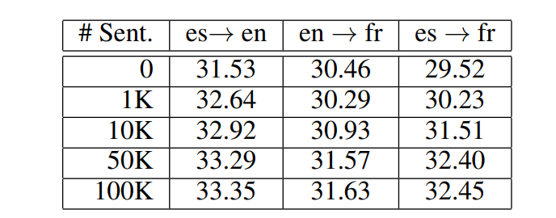
Effect of the Data Size of Bridging Corpora (Likelihood Connection)
Effect of the data size of source-to-target parallel corpora (Bridge Corpora)
Notes:
We also investigate the effect of the data size of bridging
corpora on the likelihood connection. Table 7 shows that using
a small parallel corpus (1K sentence pairs) has made a
measurable improvement. When more than 50K sentence
pairs are added, the further improvements become modest.This finding suggests that a small corpus suffices to enable the
likelihood connection to reach the reasonable performance

Slide 20
Conclusion
We present joint training for pivot-based neural machine translation to alleviate the error propagation problem.
Experiments on different language pairs confirm that our approach achieves significant improvements.
It is appealing to combine source and pivot sentences for decoding target sentences [Firat et al., 2016] or train a multi-source model directly [Zoph and Knight, 2016]

Slide 21
THANK YOU

